Slide 1

Online News Popularity Dataset
Professors: Jacinto Estima e Vala Rohani
Students: Marcelo Pereira, Daniel Marçal
Machine Learning 2019/2020
26-06-2020

Slide 2
CONTENTS
Introduction to the dataset
Data preparation
Methods used and why
Development
Results/Discussion
Global appreciation

Slide 3
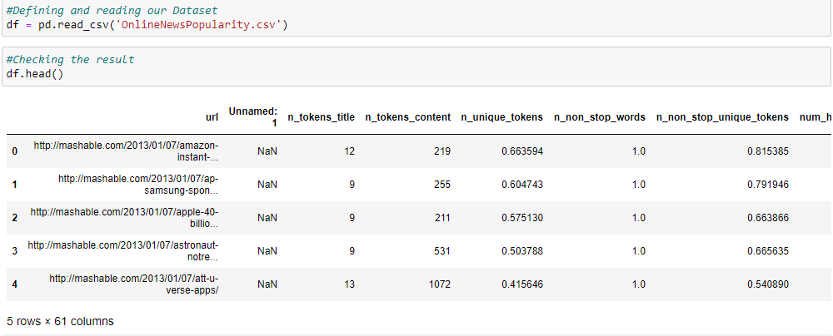
INTRODUCTION TO THE DATASET
The dataset we decided to choose for this project is about online news popularity;
Our goal was to make a regression model good enough to understand which features impacted more our target and in which parameter was the impact;
The dataset is build around 60 features and 1 target, the shares;
All the 60 features are related with data regarding the news and the shares determine it’s popularity;

Slide 4
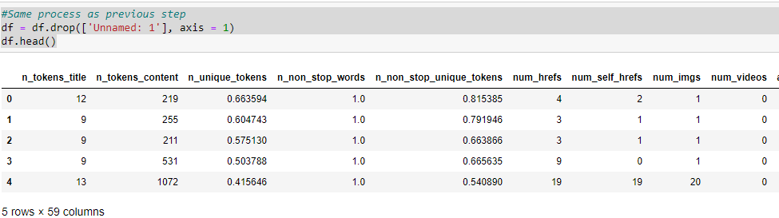
DATA PREPARATION
As seen in the last slide picture, the second columns was “Unnamed: 1” because it was our way to work around a bug where when we used the correct code for column deletion it didn’t recognize it as a column, although we tried multiple solutions.
Besides this, we removed both the 1st and 2nd columns as they were non predictive and wouldn’t affect our model in any way, since one of them was “url” and the other the “time delta”, respectively;
Every library needed was imported as shown in the already delivered notebook;

Slide 5
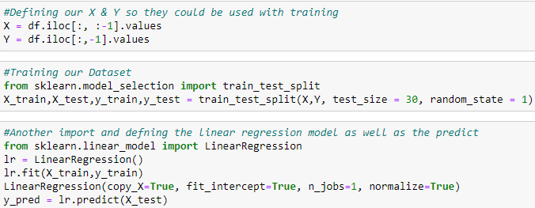
METHODS USED AND WHY
As we already mentioned, the number of features was somewhat high to work with;
Because of this, we planned two different approaches: The 1st one, normalization, since we had a lot of different ranges of values for each column. The latter was using Backwards Elimination Method, due to the main objective of the project being building a ML linear regression model with multiple variables;

Slide 6
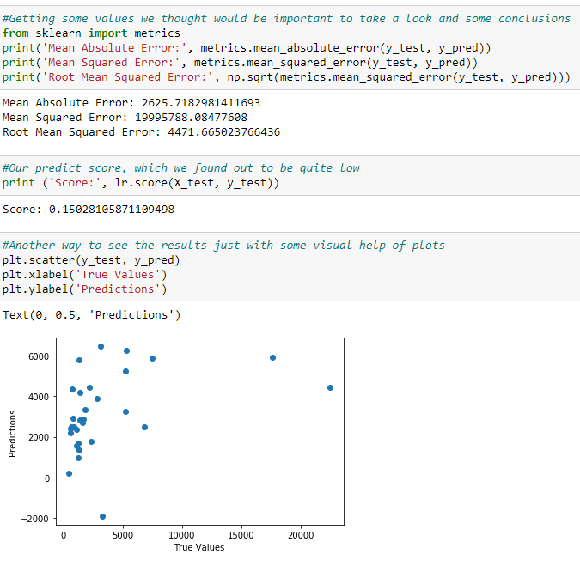
METHODS USED AND WHY
This was the measures we decided to take note before studying every single feature that helped us to figure out the perfect ML model to implement after;

Slide 7
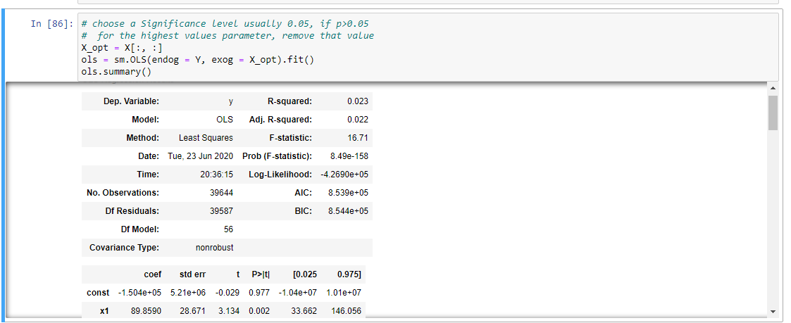
DEVELOPMENT
The method we found more appropriate was, as we already discussed, the Backwards Elimination Method. It consists on multiple iterations of choosing the significance level (p-value), a value that was different in our iterations as we wanted to conclude of much of an impact changing it would do. Each iteration deleted the values with the p-value > significance level and with the results of this iteration if any value was again above the standard p-value the process was repeated until no longer value was above it. In every one of them it had a new fit and we took note of some important data for conclusions, such as R-Squared and standard-deviation.
For the most part, our significance level was 0,05.

Slide 8
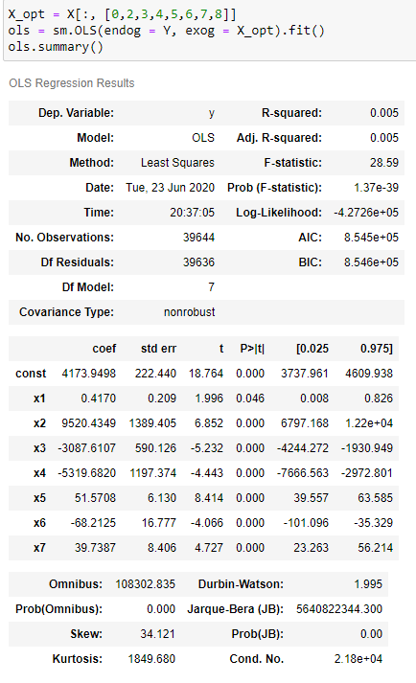
RESULTS/DISCUSSION
This process was repeated for multiple iterations and we got significant changes when our significance level = 0,05;
We ended up with only seven relevant features from the 60 or 58, if you prefer, that we started with;
Some big results were: p-value from 0,977 to < 0,000, R-Squared from 0,023 to 0,005 and standard deviation from 771,621 to 222,440

Slide 9
GLOBAL APPRECIATION
Unfortunately, developing the Backwards method means that we didn’t know exactly which were the features with the most relevance from the last 7 we identified, although we could developed a better model and improve it from each iteration to another compared with the one we started with;
Another aspect we wanted to mention was the idea of not going anywhere as we didn’t had a crystal clear objective from the beginning;
On a good note, it was a challenging project that demand us to do a lot of research and the opportunity to work with a new method and with a much larger dataset then we were used to;

